Slide 1

Rescheduling the NBA regular season via Integer Programming
Juan José Miranda Bront and Nicolás García Aramouni
Universidad Torcuato Di Tella, Argentina

Slide 2



The multiple challenges coming from the COVID19 Pandemic
Health
Challenges in multiple fronts
COVID19
Economic
Unexpected in almost all contexts.
Organization responded having little and imprecise information.
Safety measures, lockdowns and responses varied across countries.
Notes:
Explicar tours para aprovechar las distancias de Argentina
Mencionar que el cambio de la temporada 2017-18 es por muchos partidos

Slide 3
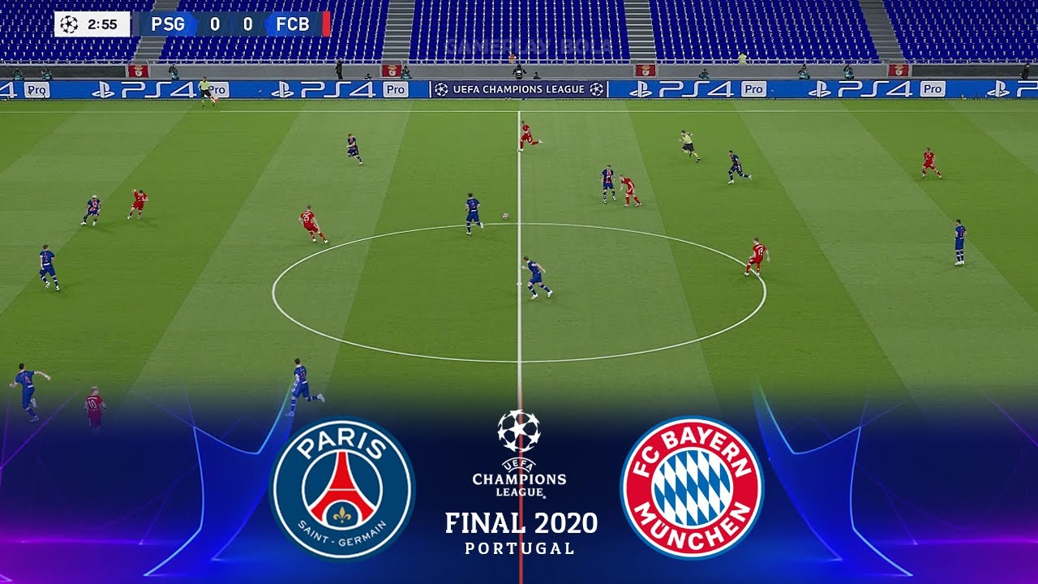
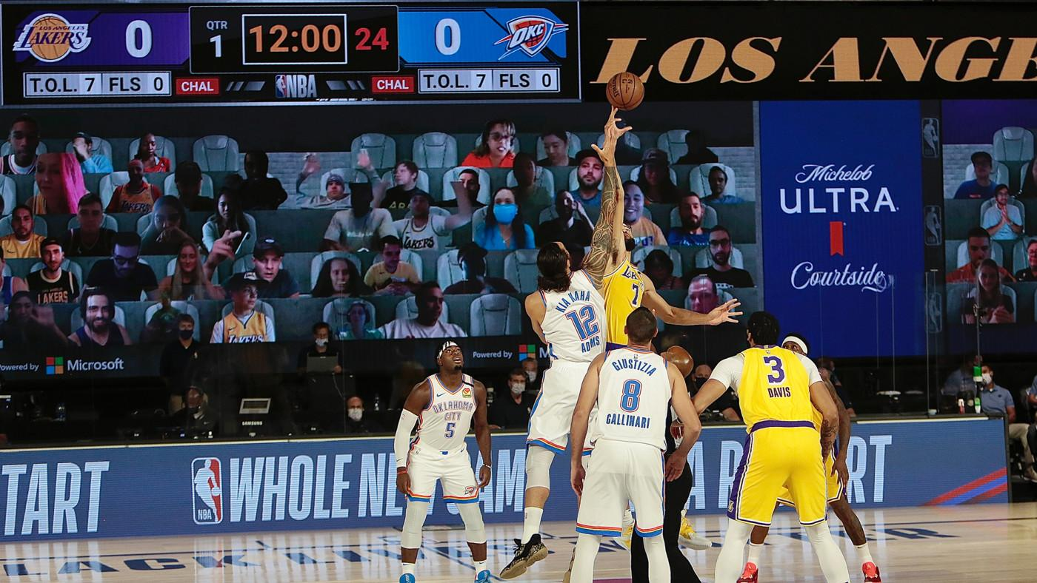
Impact in sport leagues around the world
UEFA Champions
League Final
(2020)
NBA Bubble (2019 - 2020)
Notes:
Explicar tours para aprovechar las distancias de Argentina
Mencionar que el cambio de la temporada 2017-18 es por muchos partidos

Slide 4
Rescheduling matches pre and post COVID
Pre-COVID
COVID
34%
Probability of a match being suspended in the NBA 2020-21 season, given than the previous match was suspended
Suspended matches are rare
Suspensions are usually not related to each other
Suspended matches are more common due to the health situation
If multiple players become sick, consecutive games might be suspended
Notes:
Explicar tours para aprovechar las distancias de Argentina
Mencionar que el cambio de la temporada 2017-18 es por muchos partidos

Slide 5
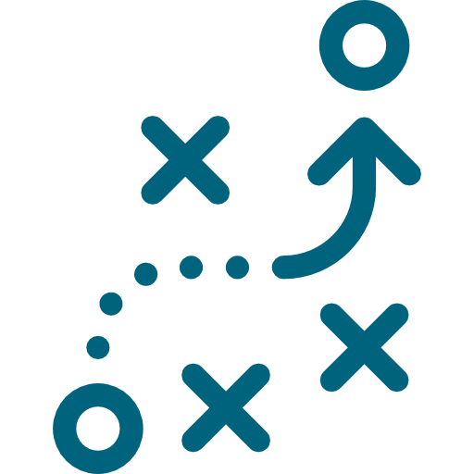


Rescheduling in sports
Two types of responses
Proactive
Reactive
Literature
Yi et al (EJOR, 2020) present proactive and reactive strategies for time-constrained schedules
Yi et al (ANOR, 2022) present proactive and reactive strategies for time-relaxed schedules
Practice
Leagues like NBA, NHL and MLB have rescheduled games, but haven’t disclosed their methodological approach
Rescheduling necessities
Notes:
Explicar tours para aprovechar las distancias de Argentina
Mencionar que el cambio de la temporada 2017-18 es por muchos partidos

Slide 6
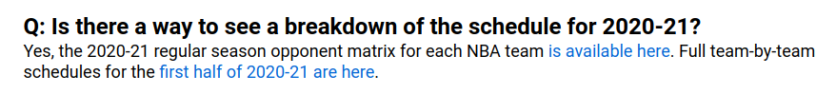
The 2020 - 2021 NBA Season
The NBA applied the following contingency actions during the season:
Proactive scheduling strategy:
Schedule only the first half of the season (All-Star Game);
Postpone games if a teams has insufficient players to the second half;
Generate a schedule for the second half + suspended games
Ad-hoc reschedule for games suspended during the second half.
72
Games per team
31
Suspended games
3%
Games suspended
Notes:
Explicar tours para aprovechar las distancias de Argentina
Mencionar que el cambio de la temporada 2017-18 es por muchos partidos

Slide 7
Our approach: a reactive strategy
Definition
Each game in the executed timetable that is played before or after its scheduled round is considered a disruption. In our setup, each suspended game will therefore translate into a disruption that needs to be rescheduled in the remaining of the season schedule
Research Question
Can we systematically generate an adjusted fixture by rescheduling postponed games within the planned schedule?
Approach: a reactive strategy
Consider as input the planned schedule for the entire season.
Insert the disrupted matches onto the existing schedule, maintaining the original scheduled dates for non-disrupted matches
We build a linear optimization model to find the best possible date for each disruption and, if we can’t, we reschedule it after the end of the schedule’s original date
Notes:
Explicar tours para aprovechar las distancias de Argentina
Mencionar que el cambio de la temporada 2017-18 es por muchos partidos

Slide 8


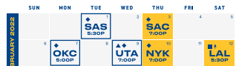
Candidate dates for each disruption
A round t must follow these conditions
1
t occurs after the date in the original schedule
2
There are no planned games for the teams involved in the disruption on date t
3
There are no scheduling rules violations if the corresponding match is scheduled on t
At most one game between consecutive non-disrupted matches.
Limit the number of matches in 7-day periods (i.e., minimum rest conditions)
4
Both teams travel a reasonable distance if the corresponding match is scheduled on t
Notes:
Explicar tours para aprovechar las distancias de Argentina
Mencionar que el cambio de la temporada 2017-18 es por muchos partidos

Slide 9
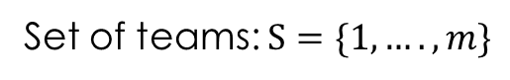
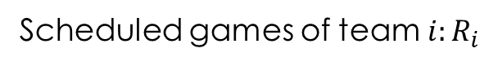
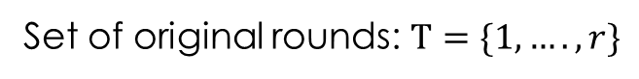
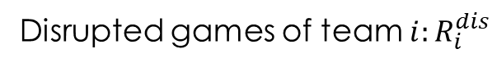
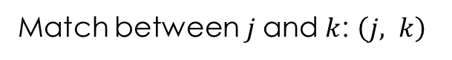
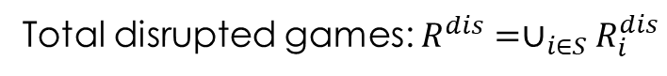
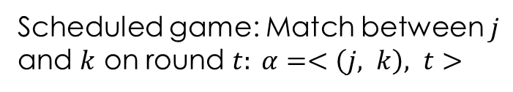
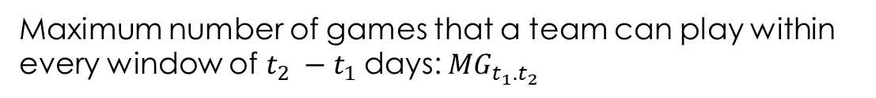
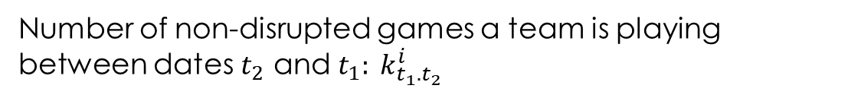
Notation and Definitions
General
Schedule Rules
Decision variables
x_{𝛂t} = 1 iff disrupted game 𝛂 is rescheduled into round t
Notes:
Mencionar que fácilmente se puede adaptar a otras situaciones (single round robin)

Slide 10
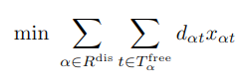
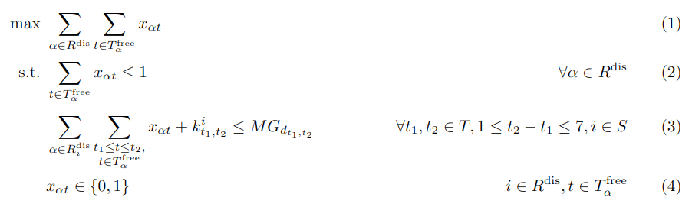
Mathematical Model (MinD)
Minimize total day difference with the original schedule
Games with feasible dates are rescheduled
=
Satisfy maximum number of games in [t₁, t₂]
Notes:
Mencionar que fácilmente se puede adaptar a otras situaciones (single round robin)

Slide 11
Preliminary experiments
Rescheduled dates for postponed games are not considered as part of the input schedule (except for some special configurations)
We consider the following metrics:
Classical from scheduling: distance, breaks.
New: # of day added and # of games played after the end of the season in the planned schedule.
Models and algorithms implemented in Python + CPLEX.

Slide 12
Rescheduling Strategies
In order to get a better understanding of the performance of our solution we try to replicate the rescheduling process for the suspended games of the 2020-21 NBA season
Rescheduling methodology
Monthly
Post All-Star
Dec
Jan
Feb
Mar
Apr
May
At the end of each month, we reschedule the disruptions that happened there.
We consider the rest of the sesason.
Dec-Jan-Feb
Mar
Apr
May
Wait until the All-Star break to reschedule first set of matches, then follow the monthly approach
Monthly* and Post All Star*
Discard the distance constraints and use the NBA’s reschedules if they happened within the month of the original game

Slide 13
Rescheduling Strategies
In order to get a better understanding of the performance of our solution we try to replicate the rescheduling process for the suspended games of the 2020-21 NBA season
Rescheduling methodology
Post All-Star
Dec-Jan-Feb
Mar
Apr
May
Wait until the All-Star break to reschedule first set of matches, then follow the monthly approach
At the end of each month, we reschedule the disruptions that happened there.
We consider the rest of the sesason.
Post All Star*
Use the NBA’s reschedules if they happened within the month of the original game

Slide 14
Main Results
Number of additional days needed after the end of the season
Metric | NBA exec | Post All Star | Post All Star*
Distance | -0.2% | 0.4% | 0.4%
Breaks | 0.6% | 0.2% | 0.7%
# Dates Added | - | 6 | 3
Games After | - | 7 | 3
Exec. Time |  | 8.85 min | 9.29 min
A
Number of games scheduled after the end of the season
B
Key Takeouts
All differences are small (around 1%)
The NBA’s proactive approach has effects on the additional number of dates needed
A
B

Slide 15
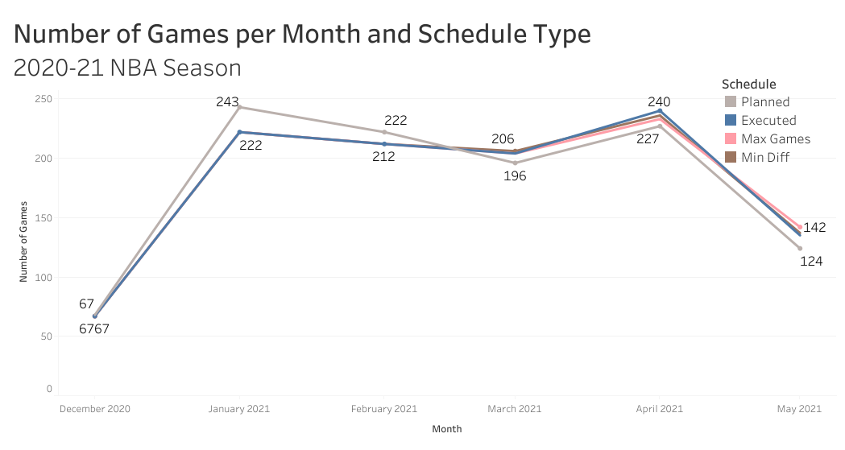
Game Calendar
A
B
Number of games per month is similar for all strategies
It appears the NBA left a less concentrated second half to have a greater buffer
A
B

Slide 16
Further Disruption Scenarios
We consider instances stressing the the number and timing of the disruptions:
15 more games: ~50% increase in the problem size
25 more games: ~80% increase in the problem size
15 more March games: Similar to a second COVID wave
Instance / Metric | Distance | Breaks | # dates added | Games after | Exec. Time
15 more games | 3.8% | -0.7% | 13 | 21 | 10.41 min
25 more games | 5.0% | -0.3% | 13 | 26 | 12.91 min
15 more games in March | 1.6% | 0.2% | 10 | 22 | 10.06 min
A
Difference against the planned NBA schedule, post All-Star strategy
A
Effects on relevant KPIs is not negligible

Slide 17
How can we improve the existing solution?
Given the current result, specially the effect on relevant KPIs of bigger instances, we might consider that a different approach is necessary:
Example
If we wanted to schedule a disruption, we would have to do it on day 6
Day | 1 | 2 | 3 | 4 | 5 | 6
Match
In this sense, we can think about matches swaps and switches!
Day | 1 | 2 | 3 | 4 | 5 | 6
Match
If we could move the game in day 3 to day 2, we could complete the schedule in 5 days

Slide 18
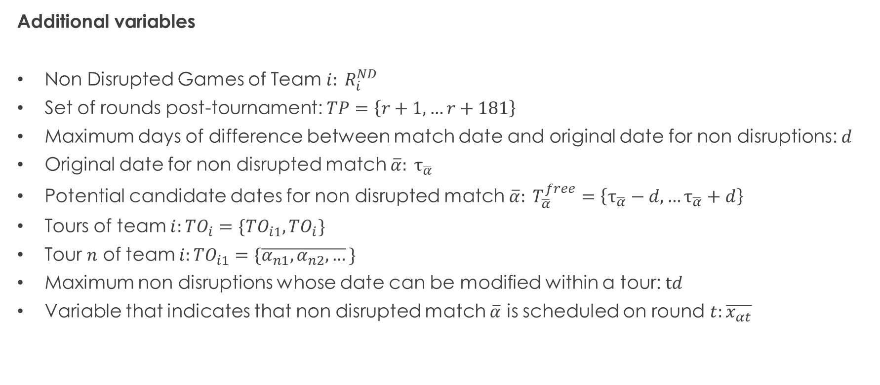
How can we adapt the existing model?
Additional variables
Non Disrupted Games of Team $i: R_{i}^{ND}$
Set of rounds post-tournament: $TP=\left\{r+1,…r+181\right\}$
Maximum days of difference between match date and original date for non disruptions: $d$
Original date for non disrupted match $\overline{α}: τ_{\overline{α}}$
Potential candidate dates for non disrupted match $\overline{α}: T_{\overline{α}}^{free}=\left\{τ_{\overline{α}}−d,…τ_{\overline{α}}+d\right\}$
Tours of team $i:TO_{i}=\{TO_{i1},TO_{i}\}$
Tour $n$ of team $i:TO_{i1}=\{\overline{α_{n1},α_{n2},…}\}$
Maximum non disruptions whose date can be modified within a tour: $td$
Variable that indicates that non disrupted match $\overline{α}$ is scheduled on round $t:\overline{x_{αt}}$

Slide 19
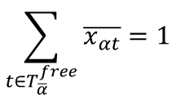
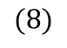
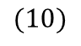
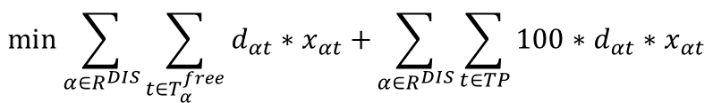
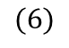
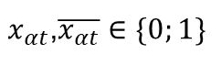
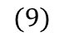
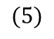
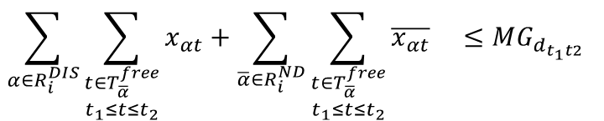
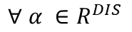
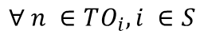
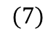
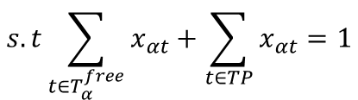
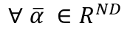
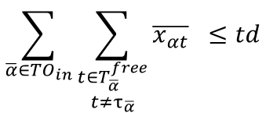
New mathematical model
$$\min{\sum_{α∈R^{DIS}}{\sum_{t∈T_{α}^{free}}{d_{αt}∗x_{αt}+}}}\sum_{α∈R^{DIS}}{\sum_{t∈TP}{{100∗d}_{αt}∗x_{αt}}}$$
$$(5)$$
$$s.t\sum_{t∈T_{α}^{free}}{x_{αt}+\sum_{t∈TP}{x_{αt}}=1}$$
$$(6)$$
$$∀ α ∈R^{DIS}$$
$$\sum_{t∈T_{\overline{α}}^{free}}{\overline{x_{αt}}=1}$$
$$∀ \overline{α} ∈R^{ND}$$
$$(7)$$
$$\sum_{α∈R_{i}^{DIS}}{\sum_{\begin{aligned}t∈T_{\overline{α}}^{free} \\ t_{1}≤t≤t_{2}\end{aligned}}{x_{αt}+\sum_{\overline{α}∈R_{i}^{ND}}{\sum_{\begin{aligned}t∈T_{\overline{α}}^{free} \\ t_{1}≤t≤t_{2}\end{aligned}}{\overline{x_{αt}}} } ≤MG_{d_{t_{1}t2}}} }$$
$$∀ t_{1},t_{2}∈T∪TP, 1≤t_{2}−t_{1}≤7, i ∈S$$
$$(8)$$
$$\sum_{\overline{α}∈{TO}_{in}}{\sum_{\begin{aligned}t∈T_{\overline{α}}^{free} \\ t≠τ_{\overline{α}}\end{aligned}}{\overline{x_{αt}}} ≤td}$$
$$∀ n ∈TO_{i}, i ∈S$$
$$(9)$$
$x_{αt}$,$\overline{x_{αt}}∈\{0;1\}$
$$(10)$$

Slide 20
New mathematical model
Minimize Day Difference Between Original and Final Date
$$\min{\sum_{α∈R^{DIS}}{\sum_{t∈T_{α}^{free}}{d_{αt}∗x_{αt}+}}}\sum_{α∈R^{DIS}}{\sum_{t∈TP}{{100∗d}_{αt}∗x_{αt}}}$$
$$(5)$$
$$s.t\sum_{t∈T_{α}^{free}}{x_{αt}+\sum_{t∈TP}{x_{αt}}=1}$$
$$(6)$$
$$∀ α ∈R^{DIS}$$
$$\sum_{t∈T_{\overline{α}}^{free}}{\overline{x_{αt}}=1}$$
$$∀ \overline{α} ∈R^{ND}$$
$$(7)$$
$$\sum_{α∈R_{i}^{DIS}}{\sum_{\begin{aligned}t∈T_{\overline{α}}^{free} \\ t_{1}≤t≤t_{2}\end{aligned}}{x_{αt}+\sum_{\overline{α}∈R_{i}^{ND}}{\sum_{\begin{aligned}t∈T_{\overline{α}}^{free} \\ t_{1}≤t≤t_{2}\end{aligned}}{\overline{x_{αt}}} } ≤MG_{d_{t_{1}t2}}} }$$
$$∀ t_{1},t_{2}∈T∪TP, 1≤t_{2}−t_{1}≤7, i ∈S$$
$$(8)$$
$$\sum_{\overline{α}∈{TO}_{in}}{\sum_{\begin{aligned}t∈T_{\overline{α}}^{free} \\ t≠τ_{\overline{α}}\end{aligned}}{\overline{x_{αt}}} ≤td}$$
$$∀ n ∈TO_{i}, i ∈S$$
$$(9)$$
$x_{αt}$,$\overline{x_{αt}}∈\{0;1\}$
$$(10)$$

Slide 21
New mathematical model
$$\min{\sum_{α∈R^{DIS}}{\sum_{t∈T_{α}^{free}}{d_{αt}∗x_{αt}+}}}\sum_{α∈R^{DIS}}{\sum_{t∈TP}{{100∗d}_{αt}∗x_{αt}}}$$
$$(5)$$
All disruptions should be scheduled in existing or extra dates
$$s.t\sum_{t∈T_{α}^{free}}{x_{αt}+\sum_{t∈TP}{x_{αt}}=1}$$
$$(6)$$
$$∀ α ∈R^{DIS}$$
$$\sum_{t∈T_{\overline{α}}^{free}}{\overline{x_{αt}}=1}$$
$$∀ \overline{α} ∈R^{ND}$$
$$(7)$$
$$\sum_{α∈R_{i}^{DIS}}{\sum_{\begin{aligned}t∈T_{\overline{α}}^{free} \\ t_{1}≤t≤t_{2}\end{aligned}}{x_{αt}+\sum_{\overline{α}∈R_{i}^{ND}}{\sum_{\begin{aligned}t∈T_{\overline{α}}^{free} \\ t_{1}≤t≤t_{2}\end{aligned}}{\overline{x_{αt}}} } ≤MG_{d_{t_{1}t2}}} }$$
$$∀ t_{1},t_{2}∈T∪TP, 1≤t_{2}−t_{1}≤7, i ∈S$$
$$(8)$$
$$\sum_{\overline{α}∈{TO}_{in}}{\sum_{\begin{aligned}t∈T_{\overline{α}}^{free} \\ t≠τ_{\overline{α}}\end{aligned}}{\overline{x_{αt}}} ≤td}$$
$$∀ n ∈TO_{i}, i ∈S$$
$$(9)$$
$x_{αt}$,$\overline{x_{αt}}∈\{0;1\}$
$$(10)$$

Slide 22
New mathematical model
$$\min{\sum_{α∈R^{DIS}}{\sum_{t∈T_{α}^{free}}{d_{αt}∗x_{αt}+}}}\sum_{α∈R^{DIS}}{\sum_{t∈TP}{{100∗d}_{αt}∗x_{αt}}}$$
$$(5)$$
$$s.t\sum_{t∈T_{α}^{free}}{x_{αt}+\sum_{t∈TP}{x_{αt}}=1}$$
$$(6)$$
$$∀ α ∈R^{DIS}$$
All non disruptions should be scheduled in possible dates
$$\sum_{t∈T_{\overline{α}}^{free}}{\overline{x_{αt}}=1}$$
$$∀ \overline{α} ∈R^{ND}$$
$$(7)$$
$$\sum_{α∈R_{i}^{DIS}}{\sum_{\begin{aligned}t∈T_{\overline{α}}^{free} \\ t_{1}≤t≤t_{2}\end{aligned}}{x_{αt}+\sum_{\overline{α}∈R_{i}^{ND}}{\sum_{\begin{aligned}t∈T_{\overline{α}}^{free} \\ t_{1}≤t≤t_{2}\end{aligned}}{\overline{x_{αt}}} } ≤MG_{d_{t_{1}t2}}} }$$
$$∀ t_{1},t_{2}∈T∪TP, 1≤t_{2}−t_{1}≤7, i ∈S$$
$$(8)$$
$$\sum_{\overline{α}∈{TO}_{in}}{\sum_{\begin{aligned}t∈T_{\overline{α}}^{free} \\ t≠τ_{\overline{α}}\end{aligned}}{\overline{x_{αt}}} ≤td}$$
$$∀ n ∈TO_{i}, i ∈S$$
$$(9)$$
$x_{αt}$,$\overline{x_{αt}}∈\{0;1\}$
$$(10)$$

Slide 23
New mathematical model
$$\min{\sum_{α∈R^{DIS}}{\sum_{t∈T_{α}^{free}}{d_{αt}∗x_{αt}+}}}\sum_{α∈R^{DIS}}{\sum_{t∈TP}{{100∗d}_{αt}∗x_{αt}}}$$
$$(5)$$
$$s.t\sum_{t∈T_{α}^{free}}{x_{αt}+\sum_{t∈TP}{x_{αt}}=1}$$
$$(6)$$
$$∀ α ∈R^{DIS}$$
$$\sum_{t∈T_{\overline{α}}^{free}}{\overline{x_{αt}}=1}$$
$$∀ \overline{α} ∈R^{ND}$$
$$(7)$$
Schedule rules must be followed
$$\sum_{α∈R_{i}^{DIS}}{\sum_{\begin{aligned}t∈T_{\overline{α}}^{free} \\ t_{1}≤t≤t_{2}\end{aligned}}{x_{αt}+\sum_{\overline{α}∈R_{i}^{ND}}{\sum_{\begin{aligned}t∈T_{\overline{α}}^{free} \\ t_{1}≤t≤t_{2}\end{aligned}}{\overline{x_{αt}}} } ≤MG_{d_{t_{1}t2}}} }$$
$$∀ t_{1},t_{2}∈T∪TP, 1≤t_{2}−t_{1}≤7, i ∈S$$
$$(8)$$
$$\sum_{\overline{α}∈{TO}_{in}}{\sum_{\begin{aligned}t∈T_{\overline{α}}^{free} \\ t≠τ_{\overline{α}}\end{aligned}}{\overline{x_{αt}}} ≤td}$$
$$∀ n ∈TO_{i}, i ∈S$$
$$(9)$$
$x_{αt}$,$\overline{x_{αt}}∈\{0;1\}$
$$(10)$$

Slide 24
New mathematical model
$$\min{\sum_{α∈R^{DIS}}{\sum_{t∈T_{α}^{free}}{d_{αt}∗x_{αt}+}}}\sum_{α∈R^{DIS}}{\sum_{t∈TP}{{100∗d}_{αt}∗x_{αt}}}$$
$$(5)$$
$$s.t\sum_{t∈T_{α}^{free}}{x_{αt}+\sum_{t∈TP}{x_{αt}}=1}$$
$$(6)$$
$$∀ α ∈R^{DIS}$$
$$\sum_{t∈T_{\overline{α}}^{free}}{\overline{x_{αt}}=1}$$
$$∀ \overline{α} ∈R^{ND}$$
$$(7)$$
$$\sum_{α∈R_{i}^{DIS}}{\sum_{\begin{aligned}t∈T_{\overline{α}}^{free} \\ t_{1}≤t≤t_{2}\end{aligned}}{x_{αt}+\sum_{\overline{α}∈R_{i}^{ND}}{\sum_{\begin{aligned}t∈T_{\overline{α}}^{free} \\ t_{1}≤t≤t_{2}\end{aligned}}{\overline{x_{αt}}} } ≤MG_{d_{t_{1}t2}}} }$$
$$∀ t_{1},t_{2}∈T∪TP, 1≤t_{2}−t_{1}≤7, i ∈S$$
$$(8)$$
No more tan td non disruptions can be changed per tour
$$\sum_{\overline{α}∈{TO}_{in}}{\sum_{\begin{aligned}t∈T_{\overline{α}}^{free} \\ t≠τ_{\overline{α}}\end{aligned}}{\overline{x_{αt}}} ≤td}$$
$$∀ n ∈TO_{i}, i ∈S$$
$$(9)$$
$x_{αt}$,$\overline{x_{αt}}∈\{0;1\}$
$$(10)$$

Slide 25
New mathematical model
$$\min{\sum_{α∈R^{DIS}}{\sum_{t∈T_{α}^{free}}{d_{αt}∗x_{αt}+}}}\sum_{α∈R^{DIS}}{\sum_{t∈TP}{{100∗d}_{αt}∗x_{αt}}}$$
$$(5)$$
$$s.t\sum_{t∈T_{α}^{free}}{x_{αt}+\sum_{t∈TP}{x_{αt}}=1}$$
$$(6)$$
$$∀ α ∈R^{DIS}$$
$$\sum_{t∈T_{\overline{α}}^{free}}{\overline{x_{αt}}=1}$$
$$∀ \overline{α} ∈R^{ND}$$
$$(7)$$
$$\sum_{α∈R_{i}^{DIS}}{\sum_{\begin{aligned}t∈T_{\overline{α}}^{free} \\ t_{1}≤t≤t_{2}\end{aligned}}{x_{αt}+\sum_{\overline{α}∈R_{i}^{ND}}{\sum_{\begin{aligned}t∈T_{\overline{α}}^{free} \\ t_{1}≤t≤t_{2}\end{aligned}}{\overline{x_{αt}}} } ≤MG_{d_{t_{1}t2}}} }$$
$$∀ t_{1},t_{2}∈T∪TP, 1≤t_{2}−t_{1}≤7, i ∈S$$
$$(8)$$
$$\sum_{\overline{α}∈{TO}_{in}}{\sum_{\begin{aligned}t∈T_{\overline{α}}^{free} \\ t≠τ_{\overline{α}}\end{aligned}}{\overline{x_{αt}}} ≤td}$$
$$∀ n ∈TO_{i}, i ∈S$$
$$(9)$$
Variable domain
$x_{αt}$,$\overline{x_{αt}}∈\{0;1\}$
$$(10)$$

Slide 26
Effects on relevant KPIs
To get an understanding on the effect of this possible changes, let’s analyze the results with a Post All Star scheduling strategy with our biggest instance: original disruptions + 25 new ones:
A
B
When we increase the potential adjustment, logically, total distance increases
However, the number of additional dates needed to complete the tournament decreases
A
B
* Against original planned schedule

Slide 27
Effects on relevant KPIs
To get an understanding on the effect of this possible changes, let’s analyze the results with a Post All Star scheduling strategy with our biggest instance: original disruptions + 25 new ones:
A
B
The possibility to reschedule more games increases complexity, although relationship is not clear
As we are not limiting the number of total reschedules, this results in approximately 15% of total games being changed
A
B
* Against original planned schedule

Slide 28
A shortcoming of this approach
Example: Original Schedule
Home Tour
Away Tour
Match | 1 | 2 | 3 | 4 | 5 | 6
Rival | A | B | C | @D | @E | @F
Our current approach might change the tour order, increasing the total distance travelled
Changed Schedule
Day | 1 | 2 | 3 | 4 | 5 | 6
Match | A | @D | C | @E | B | @F

Slide 29
Summary
We framed the problem of rescheduling in time-relaxed tournaments
We evaluate different rescheduling strategies building on MIP models
Initial results show we are obtaining similar results than the ones produced by the NBA
More stressed disrupted scenarios have a considerable impact on relevant KPIs
Schedule modifications may help reduce the impact of multiple disruptions on more stressed scenarios
Next steps
Limit potential changes in order to find a good balance between additional dates needed to complete a schedule and total distance travelled
Elaborate new model that enumerates potential tour changes and finds a schedule that generates the minimum distance.

Slide 30

THANK YOU
Insert Image

